Slide 1


Liquid-vapor phase behavior and operating characteristics of capillary evaporator of a loop heat pipe at start-up
Paper study
Subjects: Aerothermochemistry and Combustion
Professor: Kumaresh
Presenter: Le Van Cong

Slide 2


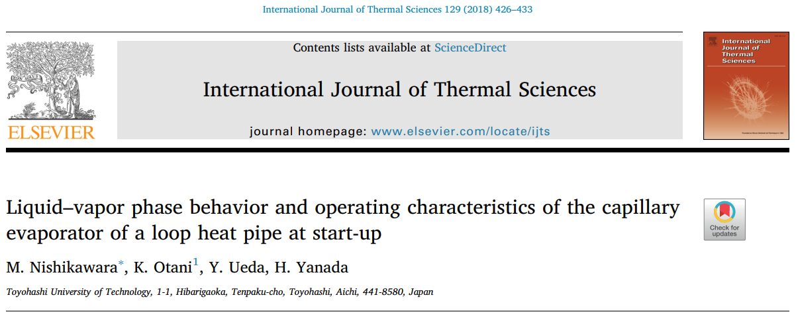

Aerothermochemistry and Combustion
13 May 2024

Slide 3
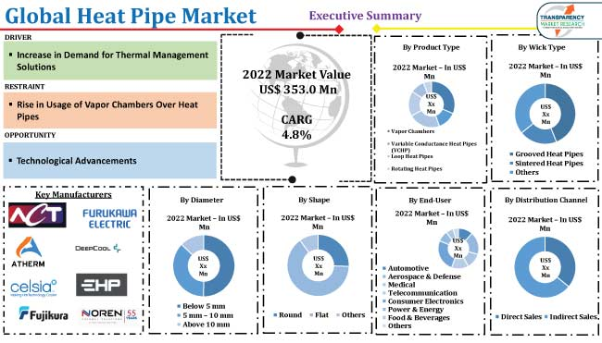
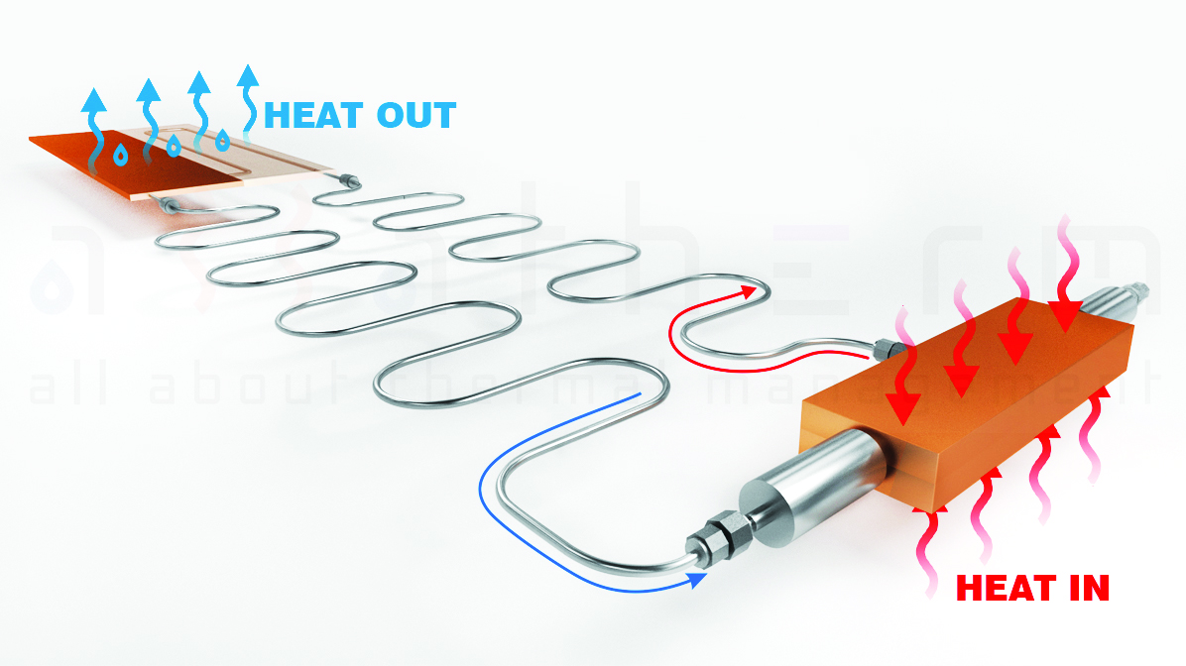
Introduction
Loop heat pipes
Loop heat pipes are two phase loop system by phase change with capillary pressure
A large growing market
Aerothermochemistry and Combustion
13 May 2024

Slide 4
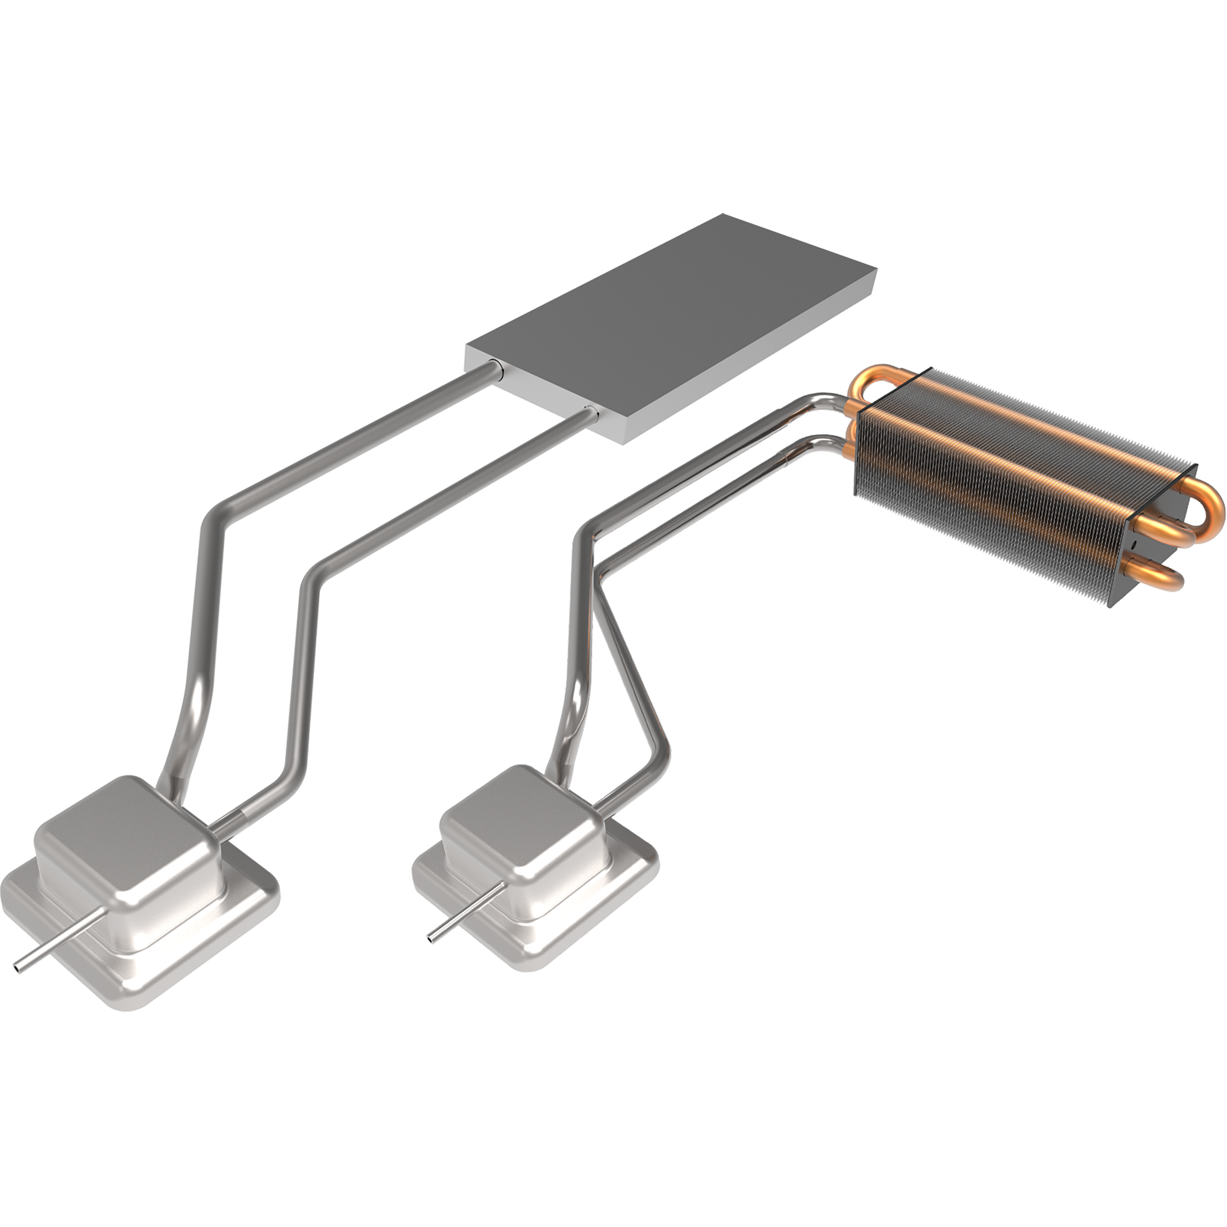
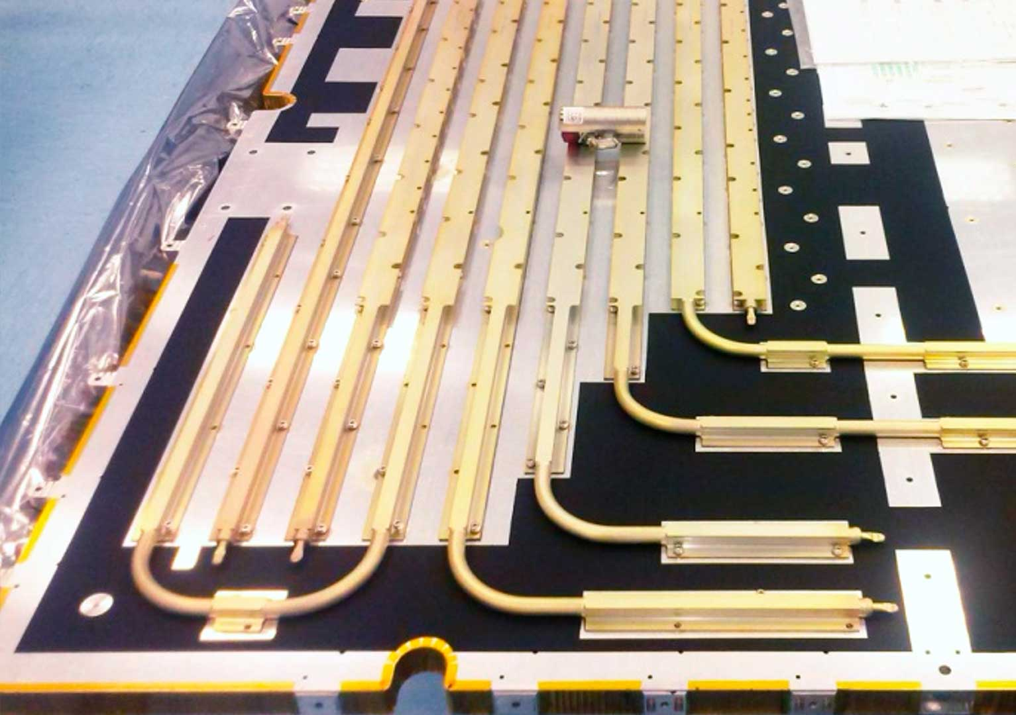
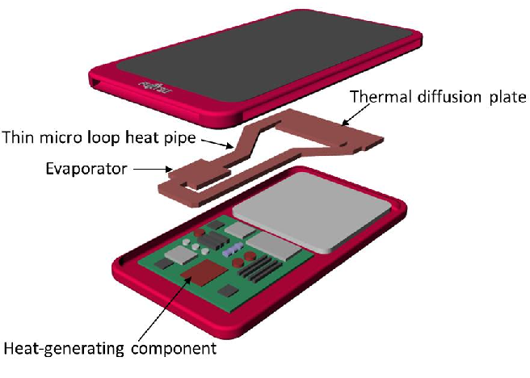
Introduction
Applications
Have a wide range of applications with different working fluids
Different applications based on system design
Satellite
Electric cooling
Mobile device cooling
Aerothermochemistry and Combustion
13 May 2024

Slide 5
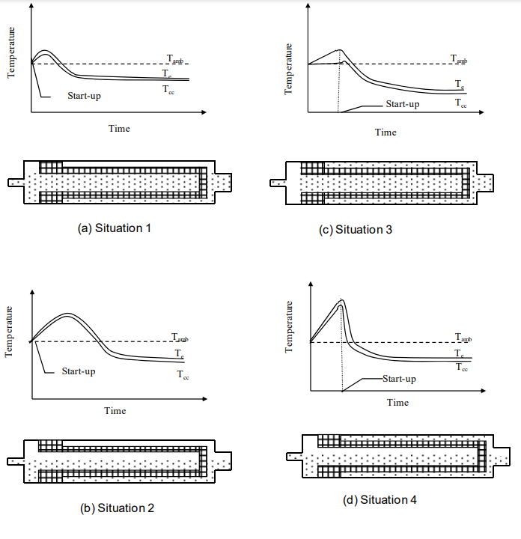
Introduction
Literature review
Start-up for LHP is very challenging depends on design and conditions
Kaya et al. reported a 251 min start up with 0.02 W/cm2
Huang et al. classified start up characteristics into 4 modes of failure, oscillating, overshoot and normal
Maydanik et al. studied initial phase distribution by filling ratio and classified into 4 situations
Start up time depends on each situation and liquid – vapor phase distribution
Aerothermochemistry and Combustion
13 May 2024

Slide 6
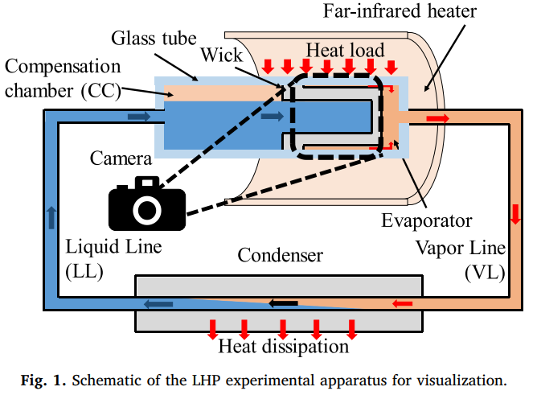
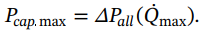
Experimental apparatus
Visualization
A max heat flux of 20 W/cm2
Capillary limit
Acetone was used as working fluid
Wick machined with 10 rectangular grooves of 2 mm width and 1 mm depth
Wick length of 47.5 mm
Aerothermochemistry and Combustion
13 May 2024

Slide 7
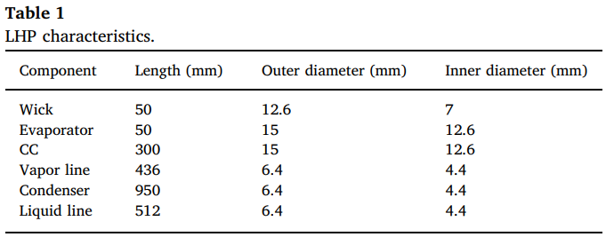
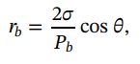
Experimental apparatus
Experimental parameters
Experiment was taken by a single micro lens reflex camera to observe liquid vapor phase states
Working fluid volume 35 ml
Pressure in LHP below 5e-4 Pa using rotary and turbo molecular pumps
Peak radius pore is 3.2 um and porosity 37%
Curvature radius is 4.4 um
Aerothermochemistry and Combustion
13 May 2024

Slide 8
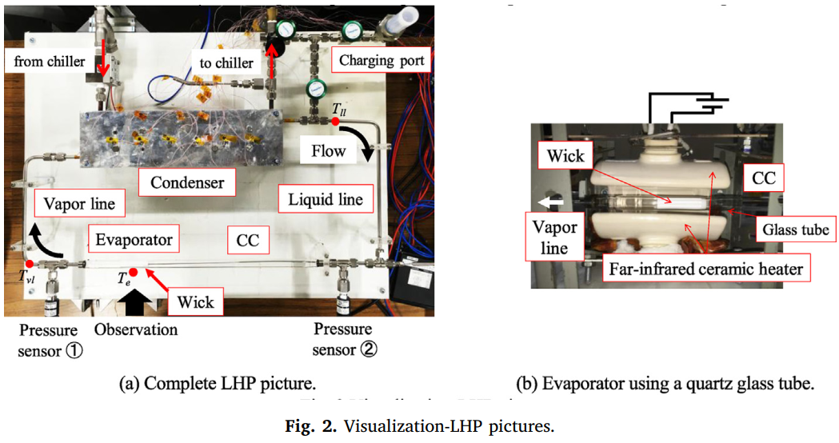
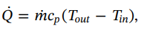
Experimental apparatus
Visualization
Aerothermochemistry and Combustion
13 May 2024

Slide 9
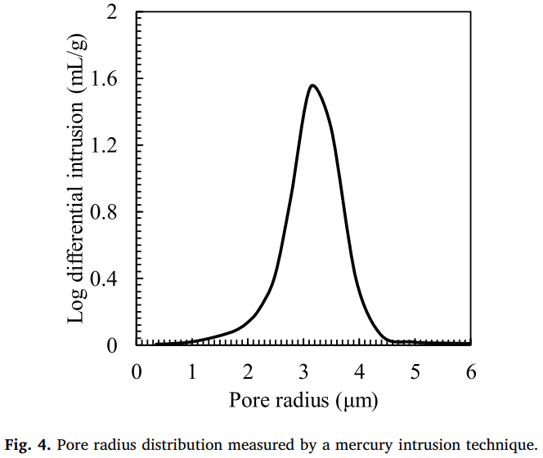
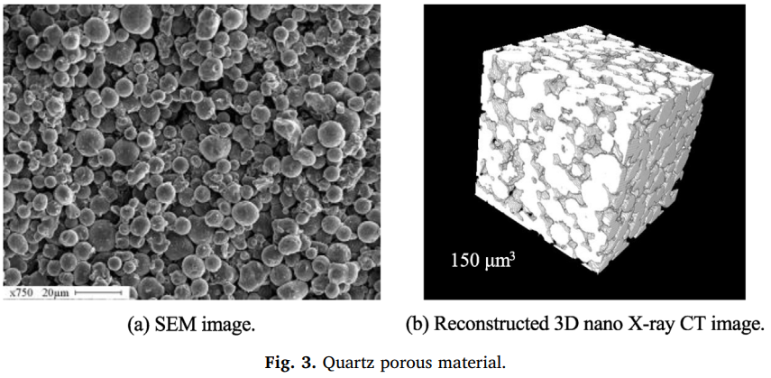
Experimental apparatus
Porous material
Aerothermochemistry and Combustion
13 May 2024

Slide 10
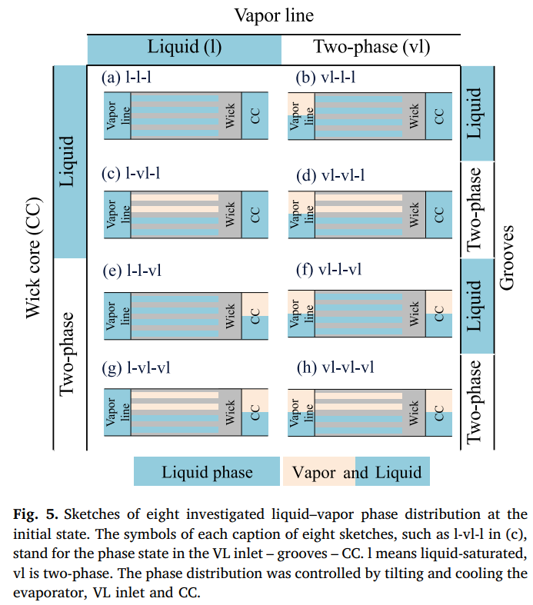
Experimental apparatus
Initial states
The phase sate in VL inlet is considered therefore, eight patterns are investigated
The phase is liquid saturated or two phase in VL inlet, grooves and compensation chamber
Aerothermochemistry and Combustion
13 May 2024

Slide 11
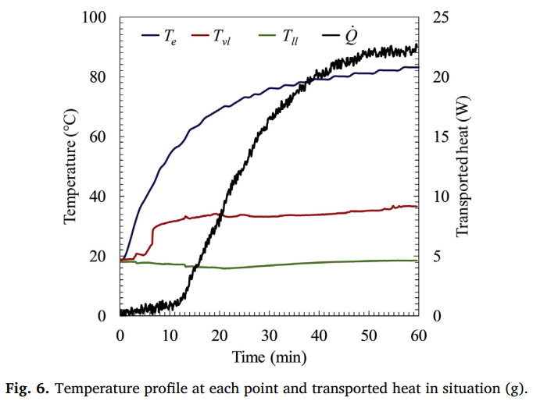
Results and discussion
Operation
Heater output 180 W
Refrigerant temperature 13 C
All conditions operation and start up successfully
Aerothermochemistry and Combustion
13 May 2024

Slide 12
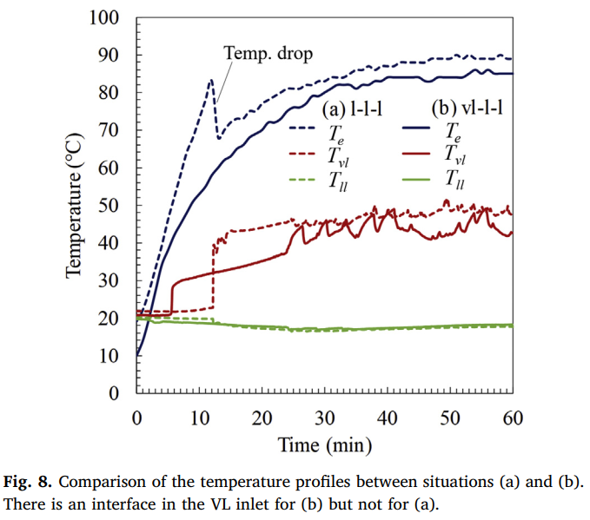
Results and discussion
Comparison
Situation (a) shows liquid saturation at all area
Situation (b) is two phase only in VL inlet and liquid saturated in grooves and CC
Situation (b) has a faster startup
Aerothermochemistry and Combustion
13 May 2024

Slide 13
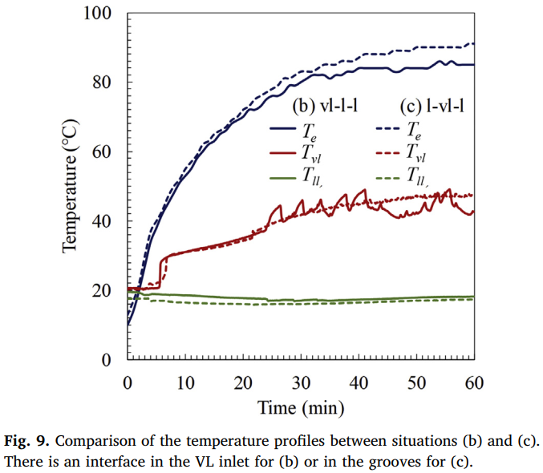
Results and discussion
Comparison
The difference is whether liquid-vapor interface is in the VL inlet or in the grooves
Aerothermochemistry and Combustion
13 May 2024

Slide 14
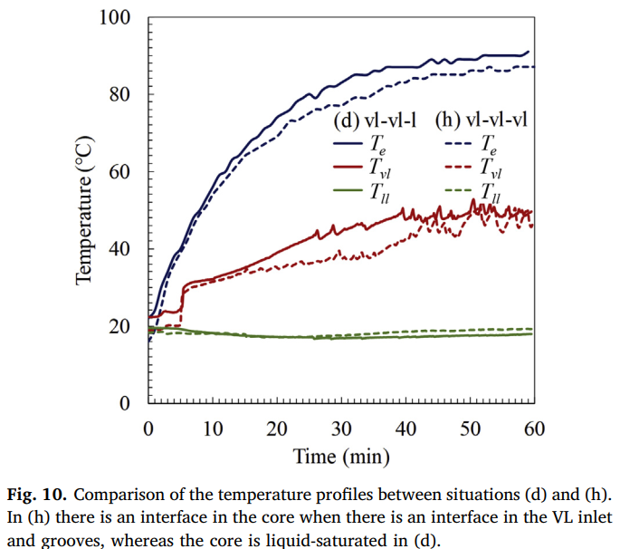
Results and discussion
Comparison
The difference is whether fluid state is two phase or liquid saturated in the CC
Aerothermochemistry and Combustion
13 May 2024

Slide 15
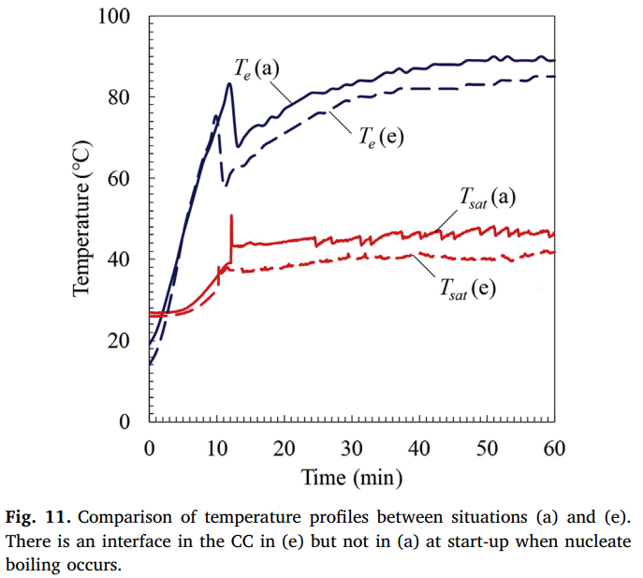
Results and discussion
Comparison
The difference is whether fluid state is two phase or liquid saturated in the CC
Temperature drop occurs in both situations
Faster in case (e)
Aerothermochemistry and Combustion
13 May 2024

Slide 16
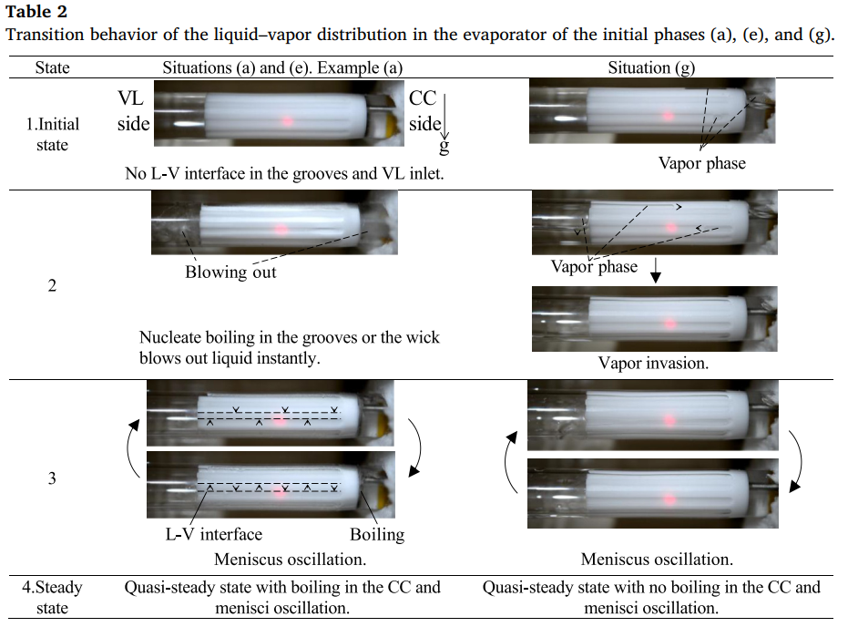
Results and discussion
Comparison
In situations (a) and (e), after start of heating, liquid is super heated and nucleate boiling occurs
The temperature increasing rate is faster
Temperature drop occurs
Meniscus oscillation occurs in situation (g)
Aerothermochemistry and Combustion
13 May 2024

Slide 17
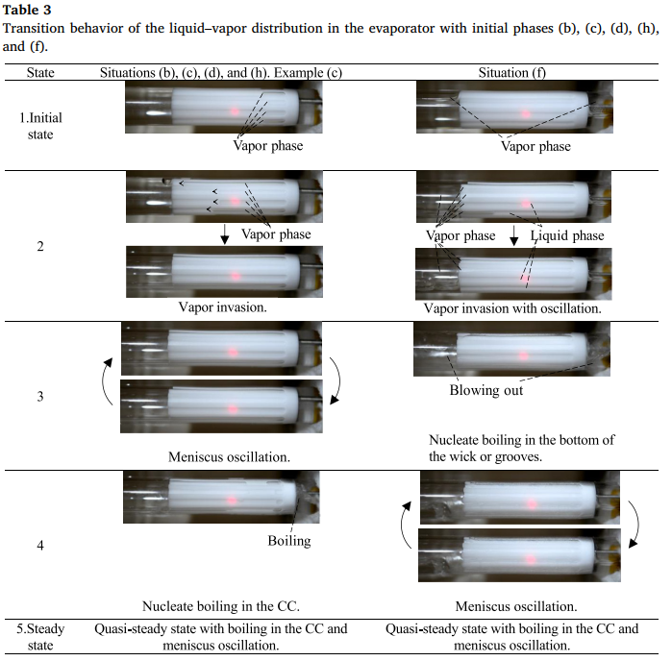
Results and discussion
Comparison
Meniscus oscillation occurs in situation (b) (c) (d) and (h)
Boiling occurs after meniscus oscillation
In situation (f) there is no Meniscus oscillation but nucleate boiling in bottom of the wick or grooves
Aerothermochemistry and Combustion
13 May 2024

Slide 18
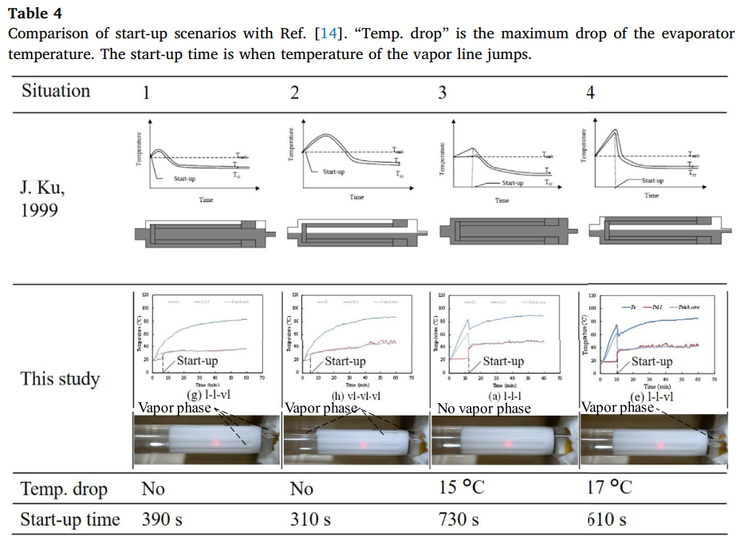
Results and discussion
Comparison
Ref. [14] shown the latest startup with situation 4 but latest startup appears in situation 3 in the paper
Differences may be attributed to differences in thermal conductivities of materials
Aerothermochemistry and Combustion
13 May 2024

Slide 19
Conclusions
Liquid-vapor displacements from startup to steady state are classified into 8 states
Transient behaviors are classified into 4 states
In most behaviors, menisci oscillation at three phase contact line within case, wick, grooves and boiling in CC are observed
Experiment provided evidence of relation between startup characteristics and initial phase distribution
Energy Materials Circulation System Laboratory
13 May 2024

Slide 20



Thank you

